Slide 1
Scrum Rituals Daily Standup

Slide 2
Week 3 & 4 Summary
Roles | Rituals | Artifacts
Scrum Master Product Owner Development Team | Sprint Planning Daily Standup Sprint Demo Sprint Retrospective | Story Product backlog Sprint backlog Scrum board Definition of "done“ Velocity charts Burndown chart Product increment

Slide 3
Week 5 Overview
Roles | Rituals | Artifacts
Scrum Master Product Owner Development Team | Sprint Planning Daily Standup Sprint Demo Sprint Retrospective | Story Product backlog Sprint backlog Scrum board Definition of "done“ Velocity charts Burndown chart Product increment

Slide 4
One- Week Sprint Ritual
(2) Daily Standup
Development
Daily Standup
Development
Daily Standup
Development
(3) Sprint Demo
(4) Sprint Retrospective
(1) Sprint Planning
Development

Slide 5
Daily Standup - Objective
A core team activity - giving everybody a regular opportunity to:
get a clear picture of what other teammates are working on
share the status of the work they're doing
Identify issues blocking progress
an opportunity for anybody outside the team who's interested in knowing what the team is working on to find out how stories are progressing
what's likely to be worked on next.
only team members present at the daily standup
anybody in the company may attend
visitors should be invited to participate as silent observers

Slide 6
Daily Standup - Time Box
Limited to 15 minutes
Kept short, made as convenient as possible so everyone can:
commit to being present, participating actively and paying attention while other people are speaking
Everyone is expected to stand, both so that they pay attention, and to encourage all participants to play their part in keeping the ritual short and focused

Slide 7
Daily Standup - Time Box
hold the standup away from desks
discourage people from using laptops and other devices during the ritual
different teams will choose different times of day to hold the stand up
in the morning
right before lunch

Slide 8
Daily Standup - Preparation
each team member thinks about how to present their progress
in such a way that it'll be clear and understandable to everybody

Slide 9
Daily Standup – (a) 3 Questions
the daily standup consists of the scrum master going around the team and asking every person three questions:
What have you done since the last stand up?
What do you plan to do until the next standup?
Is there anything blocking your progress?

Slide 10
Daily Standup – (b) Other Status Updates
Some teams update the status of their stories
For teams that are doing pair programming, the standup can be an opportunity to switch pairs, or switch stories

Slide 11
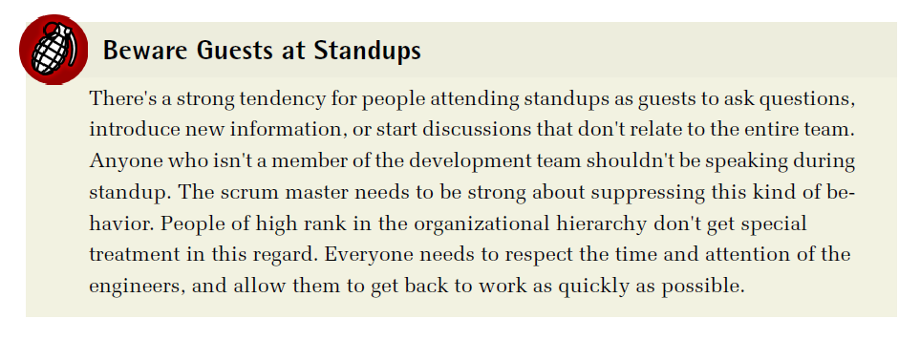

Slide 12
Scrum Artifacts - Definition of Done

Slide 13
Scrum Artifacts - Definition of Done
used to say when a story is complete
applies to each story in a sprint backlog
can evolve over time
as the team realizes what aspects of the process may need improvement during retrospectives

Slide 14
Scrum Artifacts - Definition of Done
Common expectations of a story being “done”:
the code should be complete
the build shouldn't fail
the test suite shouldn't be broken
the product should run as expected
peer reviewing code
writing new unit tests
code commenting
updating product documentation

Slide 15
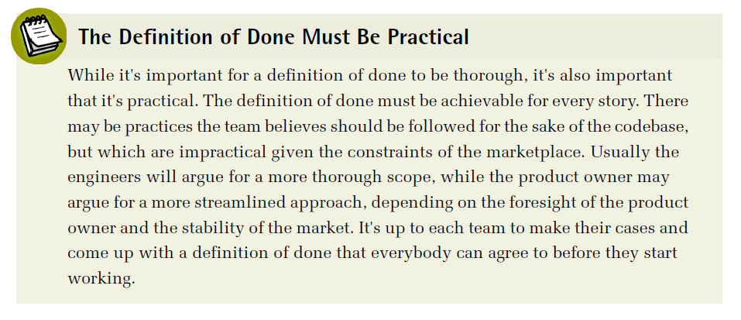
Scrum Artifacts - Definition of Done

Slide 16
Scrum Artifacts - Velocity Chart

Slide 17
Scrum Artifacts - Velocity Chart
Velocity measures the amount of work a team completes per sprint
measured from one sprint to the next
tracking the number of stories completed per sprint
build up a sense of how long it takes to complete new stories
responsibility of the scrum master
at the end of each sprint demo
calculate the number of points that were estimated for the stories that were accepted as done
added as a data point on the velocity chart

Slide 18
Scrum Artifacts - Velocity Chart
start out jumping around from very high numbers to very low numbers
longer a team works together, the better they get at consistently estimating stories

Slide 19
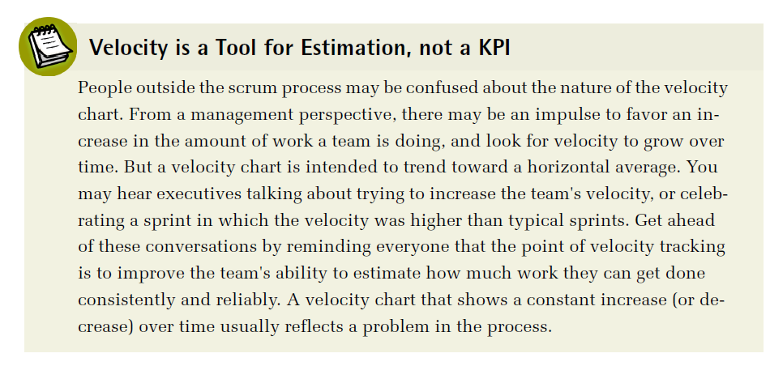
Scrum Artifacts - Velocity Chart

Slide 20
Scrum Artifacts - Burndown Chart

Slide 21
Scrum Artifacts - Burndown Chart
shows the team's progress toward completing all stories within a sprint
chart starts with the total number of estimate points the team has taken on for the sprint
tracks on a day-to-day basis how many stories have been completed and are ready for the sprint demo
maintained by the scrum master
updated daily

Slide 22
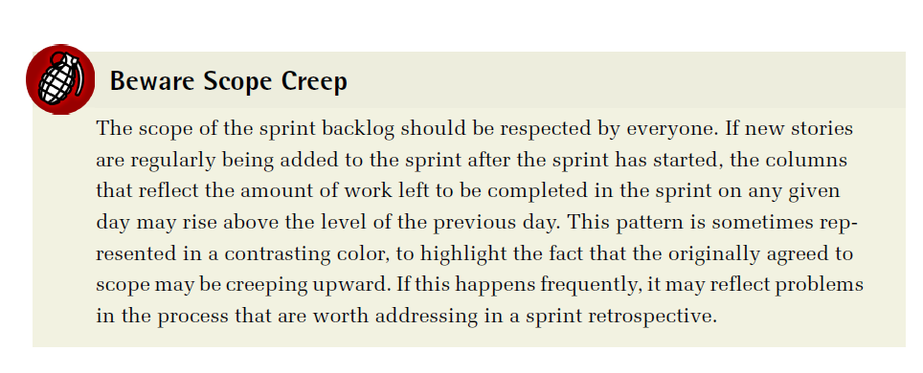
Scrum Artifacts - Burndown Chart

Slide 23
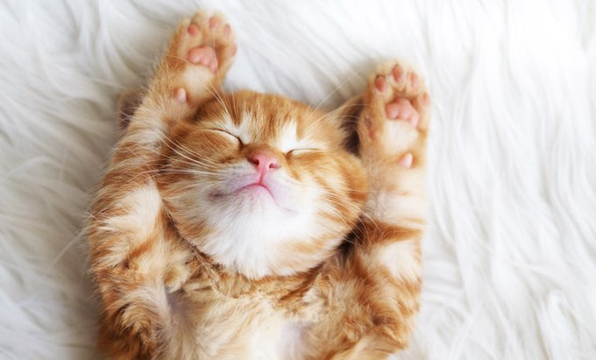
Scrum Example - WithKittens
How Scrum Works

Slide 24
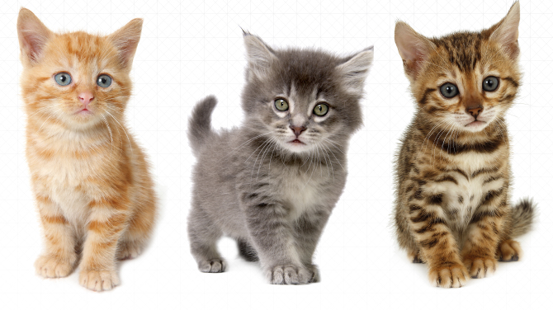
Story Background

Slide 25
Scrum Process Example - WithKittens
WithKittens team
six engineers
image processing specialists
back-end data processing
API management engineers
front-end engineers for both web and mobile interfaces
billing and security experts
one product owner
product management for both desktop and web applications
one scrum master
working together for about three years

Slide 26
Scrum Process Example - WithKittens
Other members
dedicated designer on the design team
a pair of QA engineers
a small team of DevOps engineers
site running and also handle IT issues

Slide 27
Scrum Process Example - WithKittens
unique facets of the service
figuring out the ideal positioning of kittens in pictures
best ways to optimize images for proper delivery

Slide 28
Why Just Kittens?
founder and CEO of the company has a long history of working with cat rescue societies
idea for the service began as something to support one local nonprofit organization, and grew quickly as other nonprofits
users decided they also wanted to be able to add kittens to their pictures

Slide 29
Scrum Process Example - WithKittens
produce both a website and a mobile application designed to add pictures of kittens to any image uploaded by their clients
free tier customers (most)
adding kittens to their own social media images and sharing them
paying customers (some)
for the privilege of knowing only the very best kittens will be added to their images consistently and reliably
great deal more control over the quality and content than free users get
high-end social media users
people who want more control over the way their kittens are presented in their pictures
growing business clientele, including companies who use the WithKittens service to add appeal
important to keep paying clients happy

Slide 30

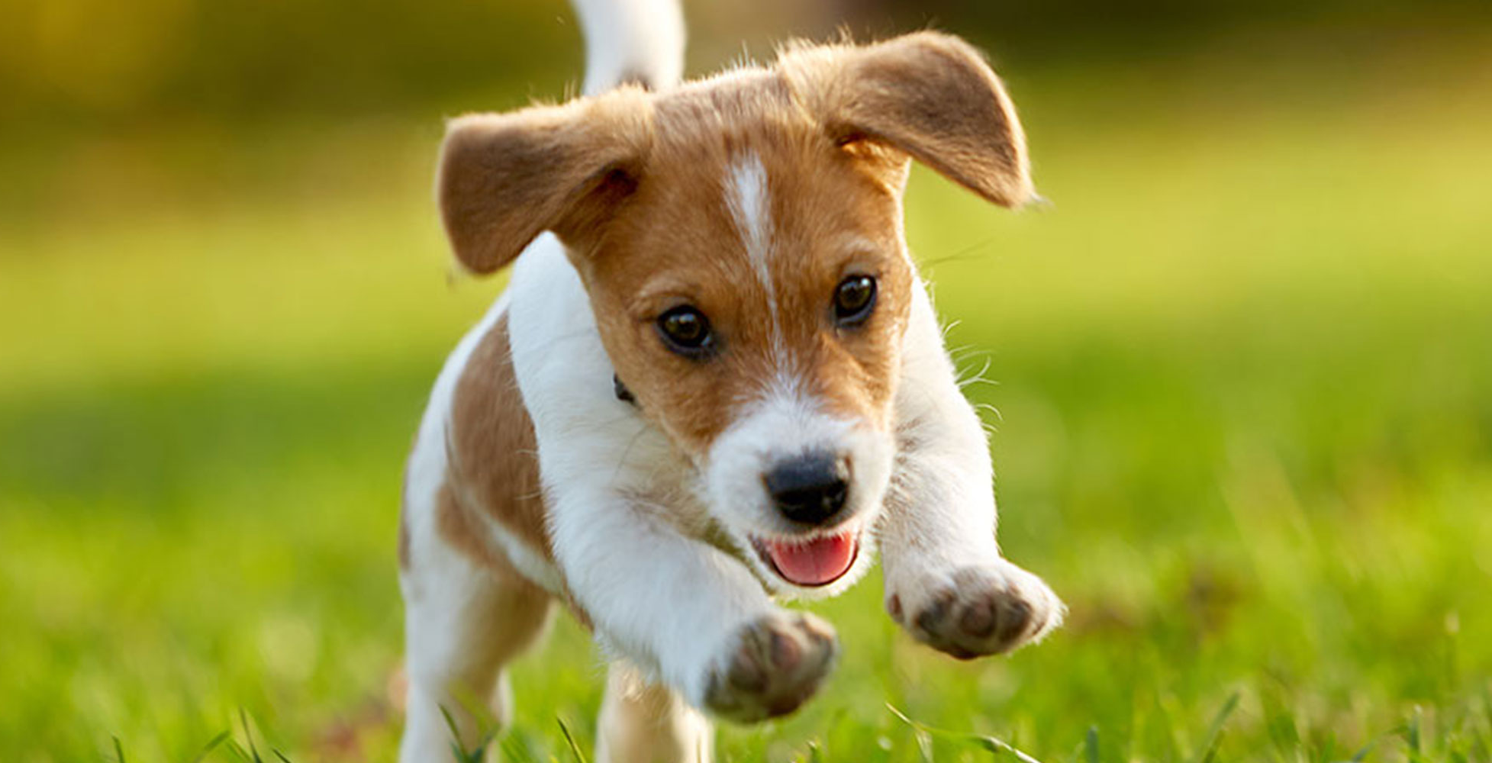
The Problem
the company's focus on kitten-only content has never been a serious issue before
but recently, the company's largest clients, a multinational marketing conglomerate were planning to switch contracts to a competitor. They puppy images

Slide 31
CEO & Product Owner
Meeting between CEO and product owner
value of adapting to changing market expectations
the appropriateness of adding a service that conflicts with the historical intent of the company
conflict with company name
decided to work on puppy-friendly features
keeping in mind are the overhead of maintaining an entirely independent service versus the cost of developing and supporting an integrated service
scheduled to work on next

Slide 32
Working Through a Story
Team completed Sprint Planning
Already prepared
Scrum Board
Product Backlog
Stories
Sprint Backlog
Team running Daily Standup for Sprint 11

Slide 33
Working Through a Story
Scrum Board at start of Sprint

Slide 34
Working Through a Story
new story (11-1)
high on the priority list
but a little lower than stories from previous sprint
compromise the product owner is moving to make so that the team won't lose momentum on stories that are almost completed

Slide 35
First stand-up
team goes around the circle
each engineer reporting
on what they've done since the last standup
what they're planning to do until the next standup
whether they have any blockers
first three engineers
clean up work to do from stories they've failed to finish in the previous sprint
no blockers
fourth engineer (jr engineer)
doesn't have any work left to do
take on a new story
Becomes story owner

Slide 36
First Standup
junior engineer: Looks like I get to take the big one
scrum master: OK, we're putting your name on it
junior engineer: I guess I'll start tasking it out, "but I'm gonna need some help. Does somebody want to pair with me?
Engineer 6: Sure, we can work together
scrum master: Great. So you two are a team, and you're working on this story. Got any blockers yet?
junior engineer: Just the usual sense of intimidation. But I guess we've got this.

Slide 37
Defining Tasks
big story
task it out
defining the individual subtasks
worked on in parallel
so that the story doesn't get trapped in one person's head
person who takes ownership
responsible for breaking out the tasks
some teams split stories during planning

Slide 38
Defining Tasks
Tasks
can be written just like stories or
written as technical specifications
can be entered into a number of scrum board
Pair of engineers responsible for the puppy story works through the sub elements
took several hours
call in the product owner to clarify points
broken out more than six tasks

Slide 39
Scrum Board after defining tasks

Slide 40
Tasks on scrum board
team members who aren't directly responsible for the whole story can still take responsibility for a task
more efficient
spreading the knowledge about how the story is implemented
Alerting QA
discuss the testing plan
decide on standards for how the tests should be evaluated to match the acceptance criteria of the original story

Slide 41
Tracking Progress
Jr Engineer & Engineer 6
determines the priority order of the tasks
start Task 1
move Task 1 to the in
progress column

Slide 42
Tracking Progress
Engineer 2
free to start working on new stories
checks the board
takes ownership of the next highest priority task (Task 2)
updates the scrum board
starts work

Slide 43
Tracking Progress
product owner
checking in with Design on the status of the assets
Scrum master
before the end of the day
checks on the status of the stories on the board

Slide 44
Second Standup
QA engineer responsible for the puppy site story attends
makes note of the status of all of the tasks
junior engineer
explains how they have broken the story into tasks
how they have begun working on the first task

Slide 45
Second Standup
junior engineer: We'd appreciate any feedback on the task breakdown. I think we addressed all of the acceptance criteria, but the more eyes we have on this the better I'll feel.
scrum master: So you'll be working on this task for the rest of the day?
junior engineer: Yeah, I think we will.
scrum master: Any blockers?
junior engineer: I don't think so.
Engineer no 6: No, I don't think we have any blockers. We should be working on this at least until tomorrow.
Scrum master: Great

Slide 46
Second Standup
During standup, Scrum Master
Continues around the circle until everybody has reported
After standup,
product owner checks in with the scrum master & engineers
lets them know that the design work has been started

Slide 47
Third Standup
All (scrum master, engineers, product owner, QA engineer) present
No blockers during update
At end, Engineers 1 speak up

Slide 48
Third Standup
Engineer 1: I have a quick question about how this puppy story is going to work with the help pages on the site. I was thinking about it last night, and it's going to be confusing for people in the beta if there's nothing on the help pages that explains what the beta is, and how to get back to the regular site.
product owner: That's a good point. Do you think that's something we can handle with the plans for the custom header?
Engineer 1: I'm not sure. The header's currently not structured to show up differently on help pages.
product owner: Is that something you think would be easy to add?

Slide 49
Third Standup
Engineer 1: I wouldn't count on it. The way the site is structured, the help pages are served separately from the rest of the content
product owner: That's right. It's going to be a tricky one.
scrum master: Do we need the whole team here for this, or can we take this offline?
product owner: I don't know
Engineer 1: Yeah, we can take this offline
scrum master: OK, great. In that case, the standup is over.

Slide 50
Third Standup
Rest of team go back to their desk
Scrum Master, Product Owner, 2 Engineers continue discussion

Slide 51
Third Standup
scrum master: Should the three of us discuss this now, or do we want to follow up on this later?
product owner: think I see what the problem is. I can write up a story that addresses the way I think it should work.
scrum master: Are we going to add that as a new story?
Engineer 1: It feels like scope creep to me
Product owner: No, I think it's covered by the acceptance criteria for the original story. These are pages on the site, and they need to be handled just like any other pages on the site
scrum master: Let's check the acceptance criteria and make sure

Slide 52
Third Standup
Check the acceptance criteria
acceptance criteria do say that the changes in the header to support beta users of the puppy site need to accommodate all of the pages on the site, without distinguishing the help pages.

Slide 53
Third Standup
Engineer 1: Well, that's going to be a tricky one
scrum master: Do we need any further details about how it should be implemented once we have the updated text from the product owner? Or can one of you take on writing up the specifications and adding this task to the board?
Engineer 1: I can do it. But it sure feels as if this might add more effort to the story than we expected.
Engineer 2: Yeah. I don't think we estimated this one with enough points.
scrum master: Well, we can't change the point estimate now. Just another data point. We'll have to do what we can.
product owner: Does that mean you don't think you're going to be able to get this story done by the end of the sprint?
Engineer 1: We'll have to see.

Slide 54
Third Standup
new task added to scrum board by Engineer 1
Inform/update Jr Engineer/story owner

Slide 55
Rest of Sprint
Continue with puppy story
Each of the tasks moves across the board from In Progress to To Demo
Code review within team
QA testing

Slide 56
To be continued….

Slide 57
Week 5 Summary
Roles | Rituals | Artifacts
Scrum Master Product Owner Development Team | Sprint Planning Daily Standup Sprint Demo Sprint Retrospective | Story Product backlog Sprint backlog Scrum board Definition of "done“ Velocity charts Burndown chart Product increment

